Slide 1
Air Quality – L4
Virendra Sethi
vsethi@iitb.ac.in
7809

Slide 2
Mixing/Dispersion
Meteorology
  Vertical
    Temperature
      Lapse Rate
  Horizontal
    Wind
      Speed
      Direction

Slide 3
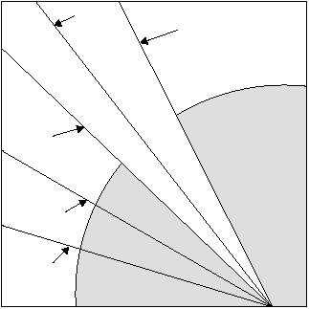
Stability
Average
Wet Lapse Rate
Dry Lapse Rate
Stable
Height ↑
Unstable
Temperature
http://www.tpub.com/content/aerographer/14312/css/14312_47.htm

Slide 4
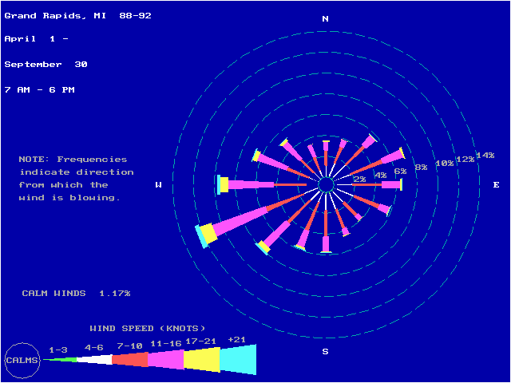
Wind Rose
1 knot = 1.82 km/hr
http://www.epa.gov/ttn/naaqs/ozone/areas/wind.htm#dlfi

Slide 5
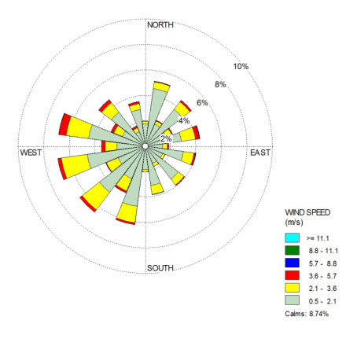
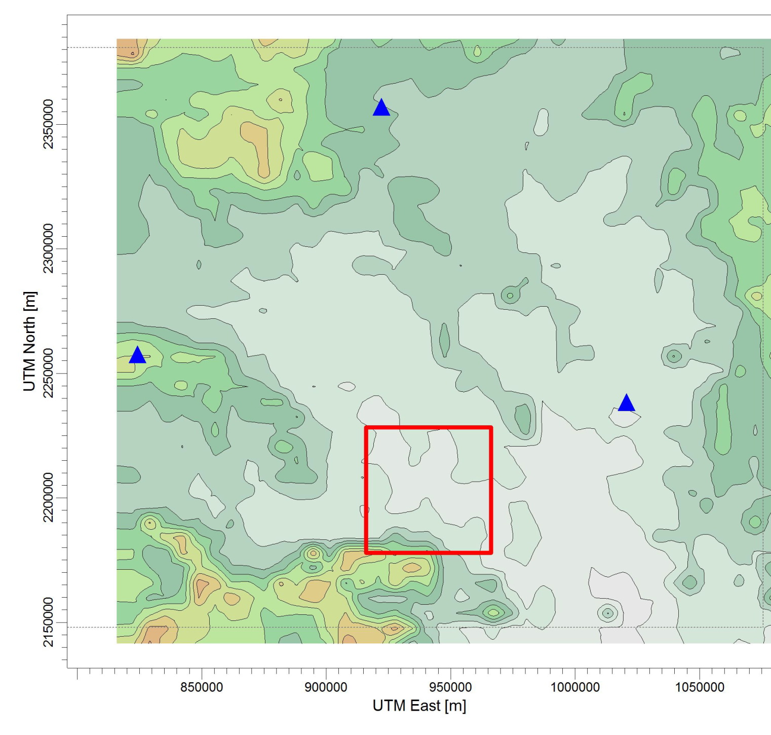
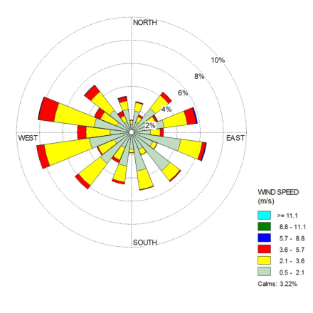
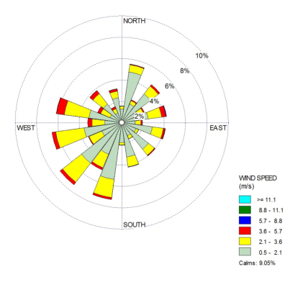
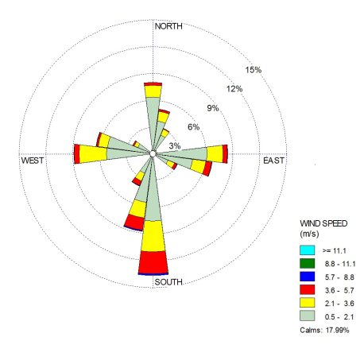
Wind conditions at 3 IMD Stations and CSTPS in Chandrapur
Nagpur
Similar
Similar
Similar
Yavatmal
Similar
Gadchiroli
Different
CSTPS
Chandrapur

Slide 6
Gentle Reminder

Slide 7
GAME BEING PLAYED
YOU are
Accountable for Air Quality in
Your City

Slide 8
Nature of Air Pollutants
Gaseous
2. Particulate Matter (PM)

Slide 9
NAAQS
National Ambient Air Quality Standards
CPCB Website :
cpcb.nic.in/air-quality-standard/

Slide 10
Air Pollution
Concentration
  mass of pollutant / volume of air
  number of particles / volume of air
  opacity
Duration – hours to days to years
Some Criteria Pollutants
  Primary
    SOx
    NOx
    CO
    PM-10
    Particulate Lead
  Secondary
    Ozone

Slide 11
How do you measure the mass concentration of PM ?
Δm/Qt
t
Δm
Q
Flow Meter
Vacuum Pump
Polluted Area/Space
Filter Cartridge

Slide 12
Gaseous Pollutants
Similar sized molecules
Behaviour
  Physics : Same
  Chemistry : Different
    EXAMPLES
      Solubility
      Toxicity
      Ozone Depletion Potential

Slide 13
Particulate Pollutants
Behaviour
  Physics : NOT the same
    Size
    Morphology
  Chemistry :
    Inert (Sand)
    Smoke (Toxic, intoxicating)

Slide 14
Perception
(Scales)

Slide 15
2 m
Elephant
2 mm
Ant
3 Orders of Magnitude

Slide 16
Ants and Elephants
Ant ~2mm
Spherical Baby Elephant ~2 m
  Order of magnitude 3
Nitrogen Molecule 0.3 nm
Respirable particle ~300 nm
  Order of magnitude 3

Slide 17
Particles in Air
Are like
Elephants
Suspended
in an
Ocean of Ants

Slide 18
Ants and Elephants
All the well established physics of “ants” (IDEAL GAS) is not applicable to the “elephants”
All the MAGIC of “nano” is in this “new” world of “elephants”
Ability to understand this range of sizes has become possible due to development of instrumentation
Last three decades have been exciting times for Aerosol Science and Engineering
  Powder Production – Material science
  Nano-products
  Atmospheric Pollutants
  Medical Sciences

Slide 19
Even within the entire range of sizes of Particulate Matter
Size decides
WHERE they would deposit in the lungs

Slide 20
Air Quality – L5
Virendra Sethi
vsethi@iitb.ac.in
7809

Slide 21
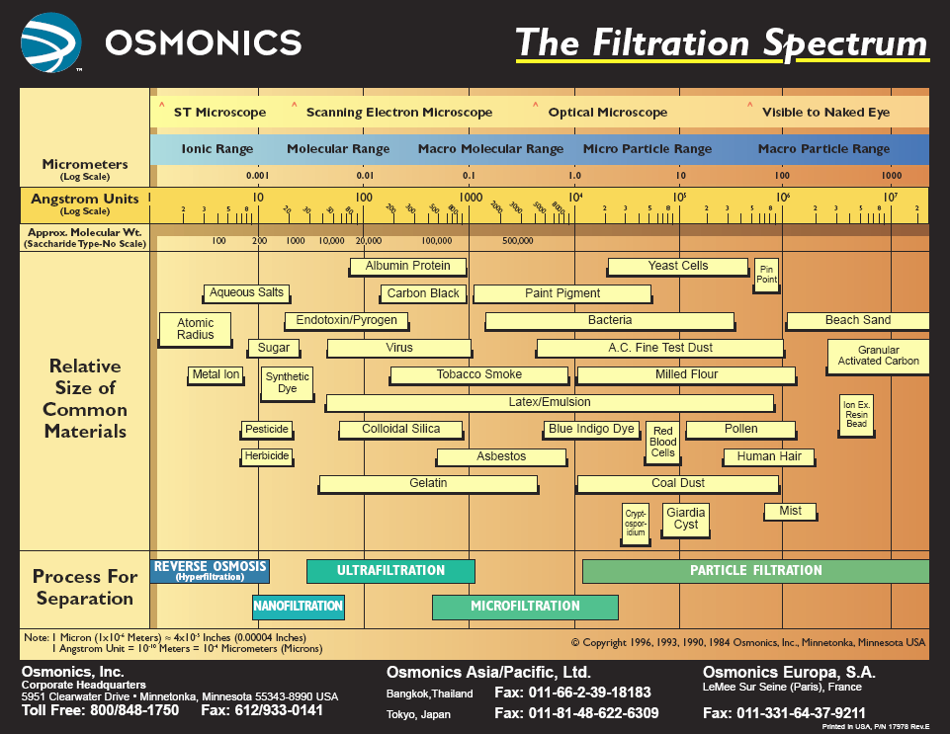
Respirable
Stopped in Nose

Slide 22
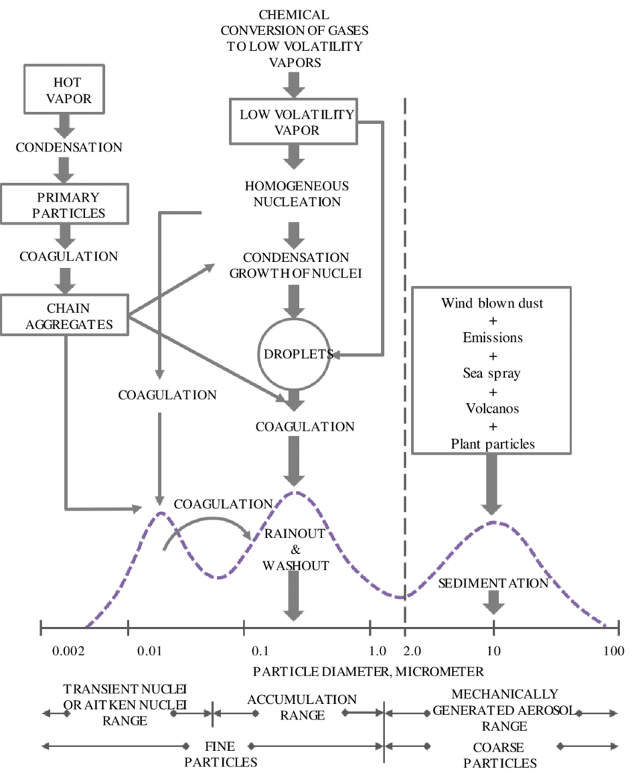


Slide 23
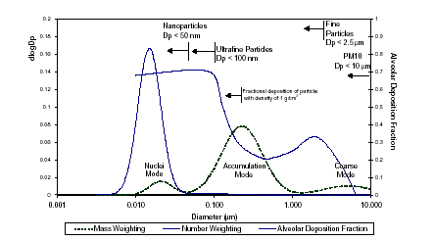

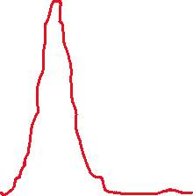



Tri-modal Particle Size Distribution
Number
Mass

Slide 24
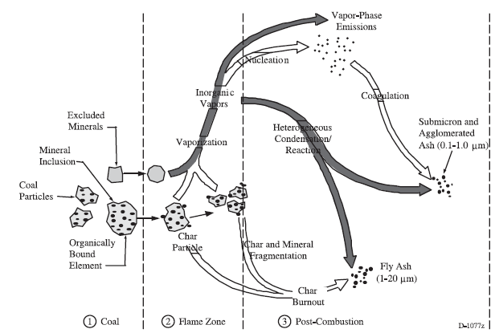
Particle formation in coal combustion
Source: Flagan and Seinfeld, 1988

Slide 25
COLLECTION / REMOVAL EFFICIENCY
1 μm
PARTICLE DIAMETER

Slide 26
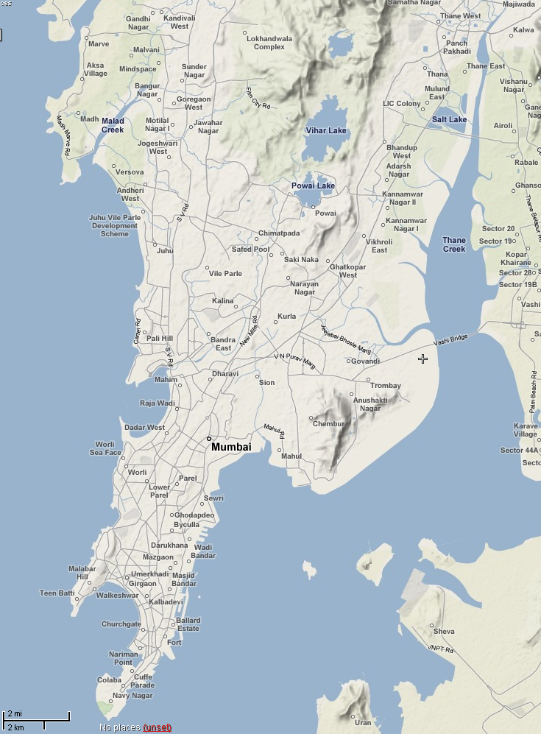
Study Area Mumbai
1. WRL (residential)
2. PAL (industrial)
1
2
Map Source: http://wikimapia.org

Slide 27
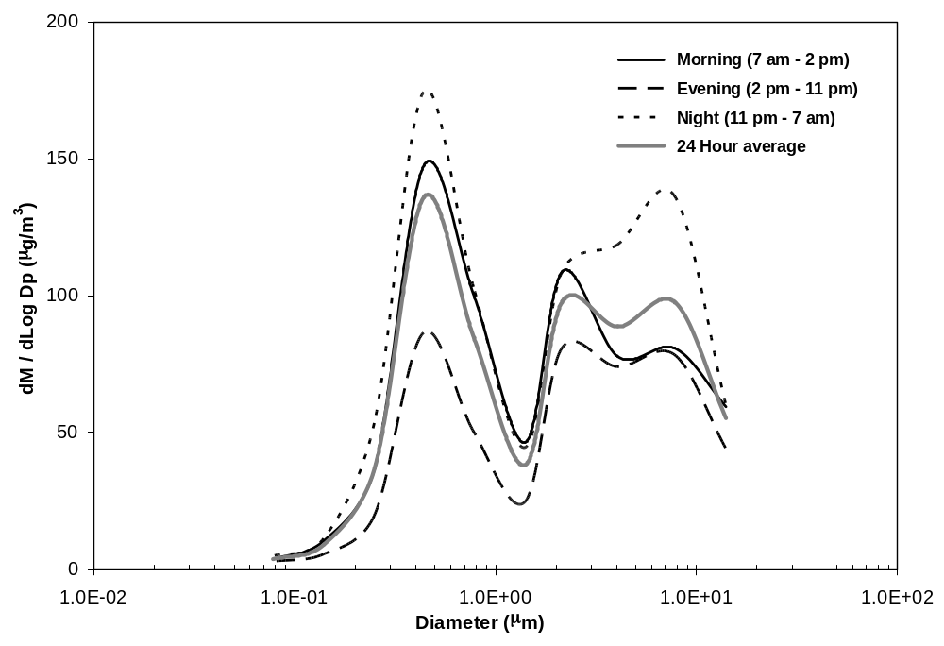
Mass Size Distributions Measured for 5 Days in Mumbai
PM2.5
PM10

Slide 28
Ratio of PM_{2.5} to PM₁₀
INDICATOR OF
ANTHROPOGENIC / COMBUSTION ACTIVITIES
Ratio Small = Benign Particulate
Ratio Large = Most particles will reach lungs and possibly more toxic

Slide 29
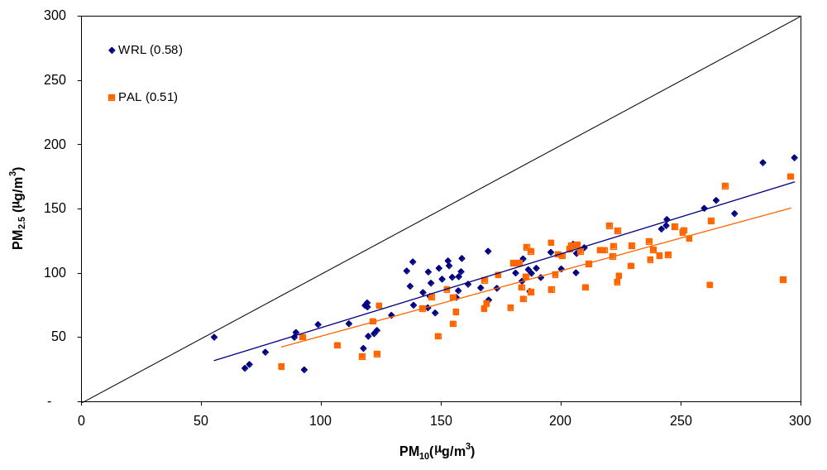
PM_{2.5} and PM₁₀ Measurements at Mumbai

Slide 30
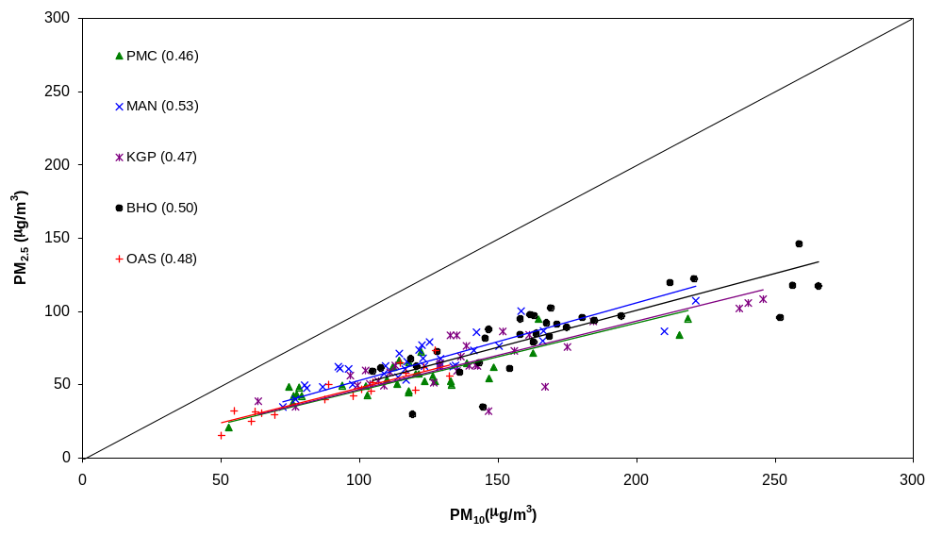
PM_{2.5} and PM₁₀ Measurements at Pune

Slide 31
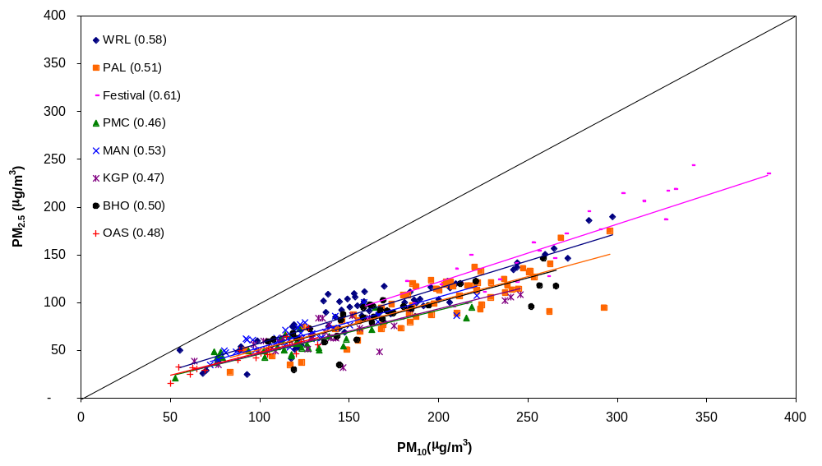
PM_{2.5} and PM₁₀ Measurements at Mumbai and Pune

Slide 32
Mass Size Distributions Measured for 5 Days in Mumbai
PM2.5
PM10

Slide 33
PM₁₀ and PM_{2.5}
PM₁₀ is the mass concentration of particulate matter less than 10 μm expressed as μg/m³
PM_{2.5} is the mass concentration of particulate matter less than 2.5 μm expressed as μg/m³

Slide 34
PM_{2.5} is a subset of PM₁₀
Plot mass distribution function
Mode in the <2.5 μm size is sourced by combustion and other anthropogenic activities. More toxic.
Area under the curve
  0 to 10 μm PM₁₀
  0 to 2.5 μm PM_{2.5}

Slide 35
Ratio of PM_{2.5} to PM₁₀
INDICATOR OF
ANTHROPOGENIC / COMBUSTION ACTIVITIES
Ratio Small = Benign Particulate
Ratio Large = Most particles will reach lungs and possibly more toxic

Slide 36
Sizing of Particles

Slide 37
How do you measure the mass concentration of PM ?
Δm/Qt
t
Δm
Q
Flow Meter
Vacuum Pump
Polluted Area/Space
Filter Cartridge

Slide 38
Thought Exercise
How would you size and count aerosol particles in the nanometer size range ?

Slide 39


Slide 40
Instrumentation
Inertial Impactors
  Mass based (> 56 nm)
Optical Particle Counters
  Number based (> 100 nm)
Electrical Mobility
  Sizing (> 6 nm)
  Counting (Condensation Nuclei Counters)

Slide 41
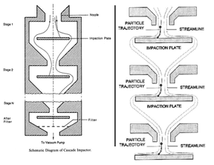
NOZZLE
Impaction Stage
Filter
TO Vac Pump

Slide 42
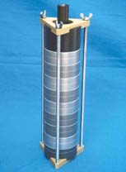
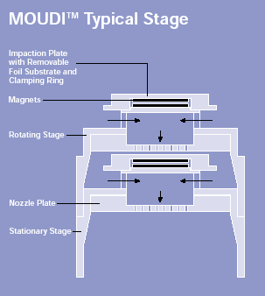
MOUDI
Micro-Orifice Uniform Deposit Impactor

Slide 43
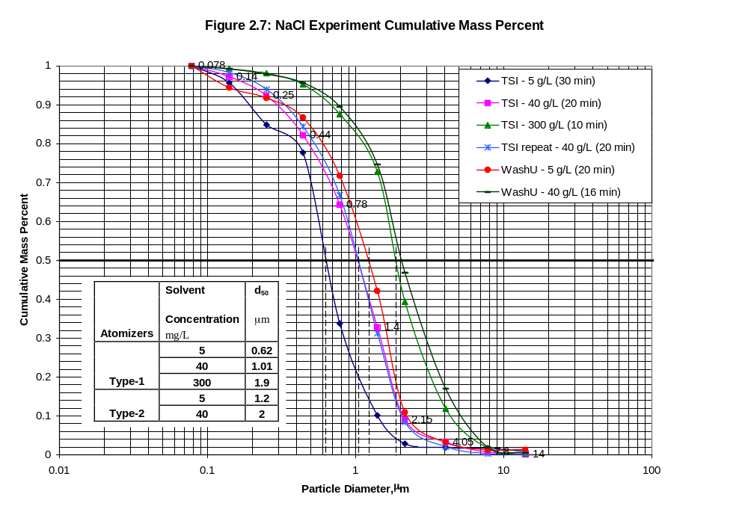

Slide 44
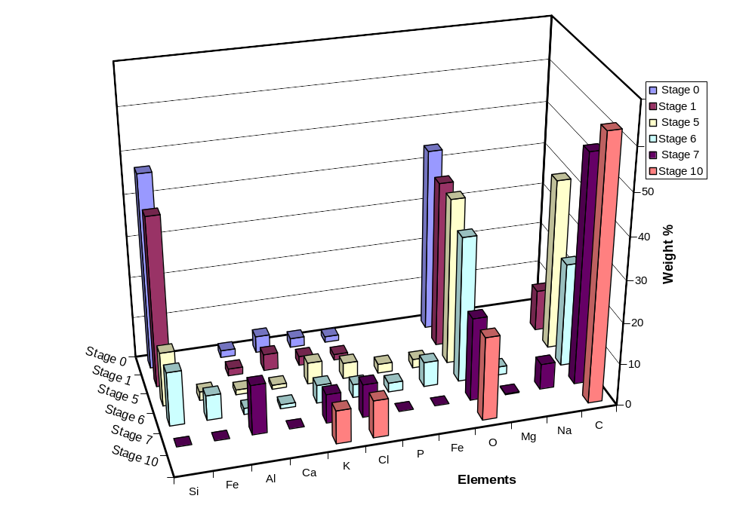
Elemental Analysis of Wood gasifier Particles
Collected from MOUDI using EDAX

Slide 45
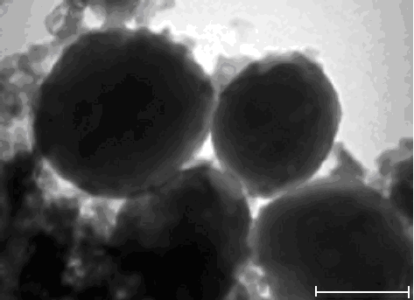
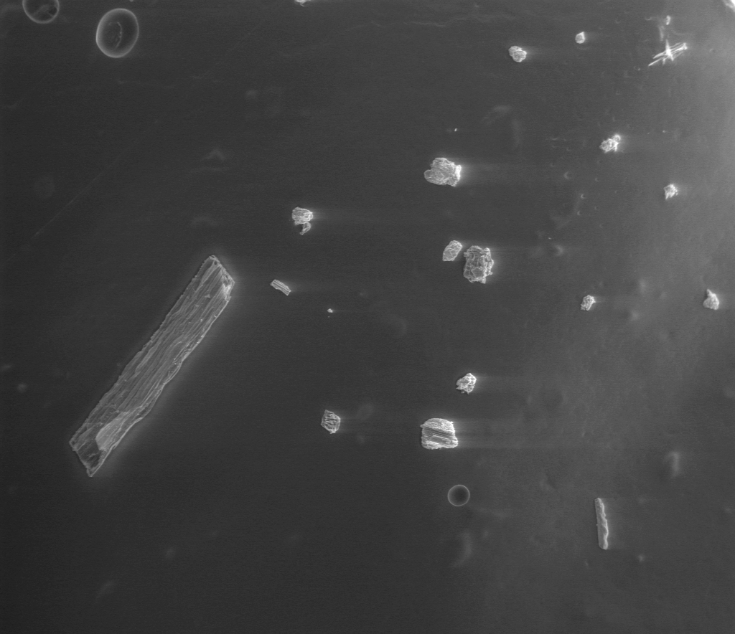
Morphology of Particles Collected from
MOUDI Stages in Raw Producer Gas from
Wood and Rice Husk Gasifiers
0.2 μm
2 μm
TEM Image of Particles from 7th Stage of MOUDI, Corresponding Cut-Size 0.56 μm
SEM Image of Particles from 1st Stage of MOUDI, Corresponding Cut-Size 10μm

Slide 46
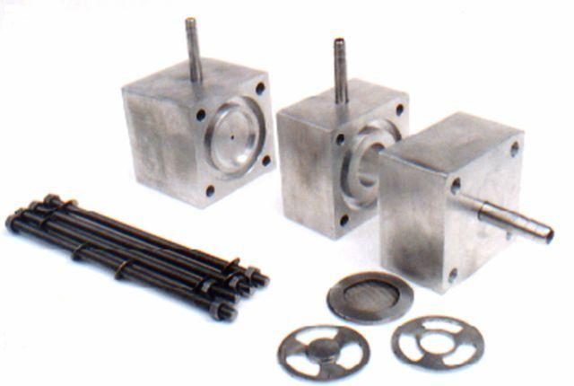
Single Stage Impactor Developed at CESE

Slide 47
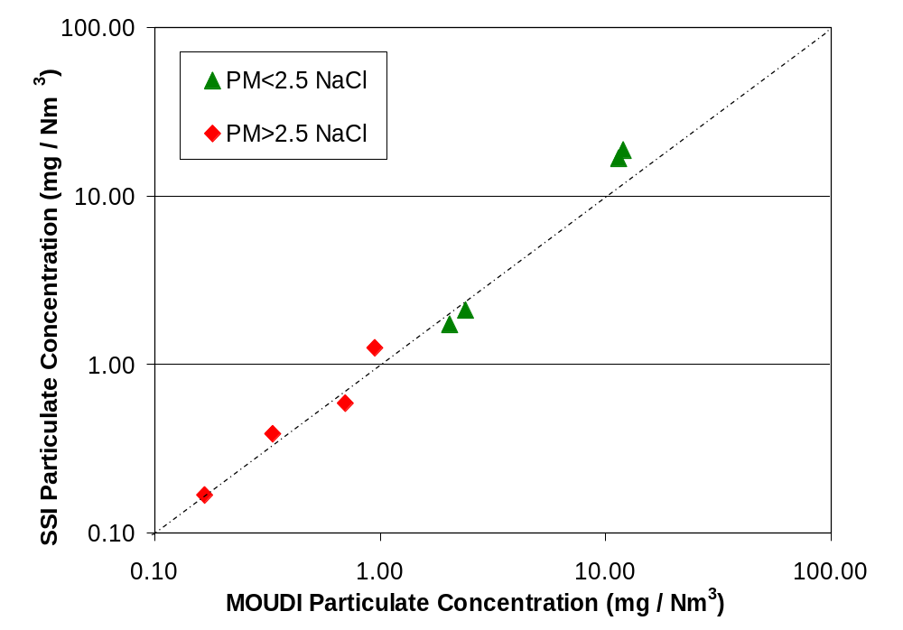
Calibration of SSI

Slide 48
Instrumentation
Inertial Impactors
  Mass based (> 56 nm)
Optical Particle Counters
  Number based (> 100 nm)
Electrical Mobility
  Sizing (> 6 nm)
  Counting (Condensation Nuclei Counters)

Slide 49
OPC’s
Light Scattering
Light Extinction
  Limited to 0.09 μm
  0.4 > λ_{opt} > 0.7 μm
Single Particle /Cloud of Particles

Slide 50
Laser Source, λ
I_{scatter}
I_{scatter}
Particle Size

Slide 51
Instrumentation
Inertial Impactors
  Mass based (> 56 nm)
Optical Particle Counters
  Number based (> 100 nm)
Electrical Mobility
  Sizing (> 6 nm)
  Counting (Condensation Nuclei Counters)

Slide 52
Electrical Mobility Analysers
Charge particles
Electrical Field
SIZE
CPC
OPC in Principle – Alcohol used to grow size

Slide 53
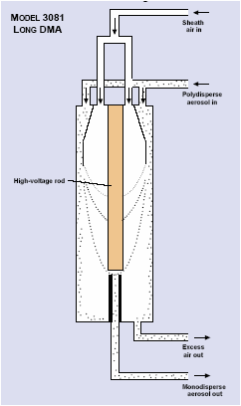
Differential Mobility Analyser (For size separation using electrical mobility)
Source : TSI Inc.

Slide 54
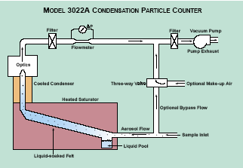
Condensation Particle Counter (For growing the size separated particles and detecting them using light scattering)
Source : TSI Inc.

Slide 55
Other Instruments For Routine Field Studies
High Volume Samplers (1.2 Lakhs)
  Regulatory (PM10m SOx, NOx)
Mini-vol Samplers (2 Lakhs)
  Regulatory (PM10, PM2.5)
Dust Trak (4 Lakhs)
  Real time (1 minute resolution)
  PMx (x = 1, 2.5, 4, 10)

Slide 56
Thank you

